Slide 1
Angular Modules & Routing

Slide 2
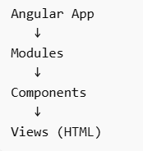
What is Angular Architecture?
Angular applications are built from:
Modules (NgModules)
Components
Services
Templates
Routing system

Slide 3
What is an Angular Module?
A decorator (@NgModule) that organizes a related set of capabilities.
Acts as a container for a cohesive block of code (components, directives, pipes).
The Root Module: Every app has at least one, usually called AppModule, which bootstraps the application.

Slide 4
What is an Angular Module?
A Module is a container that organizes related code.
Why modules exist?
Organize large applications
Improve scalability
Enable lazy loading
Separate features

Slide 5
The Metadata Properties
declarations: The components, directives, and pipes that belong to this module.
imports: Other modules whose exported classes are needed by component templates declared in this module (e.g., CommonModule, FormsModule).
exports: The subset of declarations that should be visible and usable in the templates of other modules.
providers: Creators of services that this module contributes to the global collection of services.
bootstrap: The main application view, called the root component, which hosts all other app views (only set in the Root Module).

Slide 6
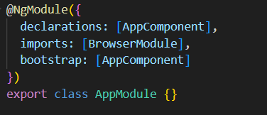
Root Module (AppModule)
Every Angular app starts with: app.module.ts

Slide 7
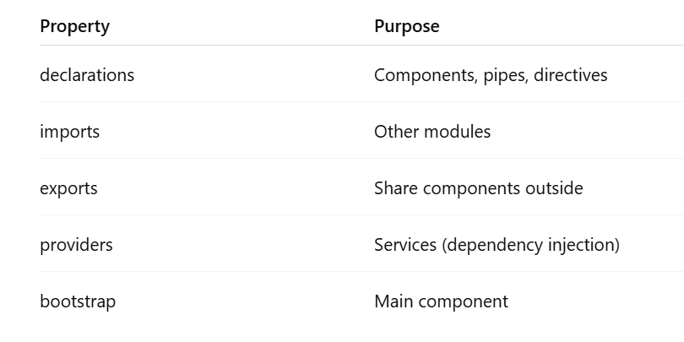
NgModule Structure

Slide 8
Angular Routing
Routing allows navigation without page reload.
Angular is a Single Page Application (SPA) framework, it doesn't load a new HTML page every time we click a link. Instead, it needs a central "anchor" to manage everything dynamically.
The "Root" refers to the starting point of an application. Think of it as the foundation of a building; everything else sits on top of it.

Slide 9
Angular Routing
Routes array: A configuration object mapping a URL path to a component.
<router-outlet>: A directive that acts as a placeholder. Angular dynamically fills it based on the current router state.
routerLink: The attribute used in HTML instead of href to navigate without refreshing the page.

Slide 10
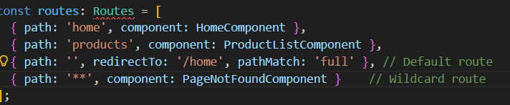
Basic Route Configuration

Slide 11
Parameterized Routes
Used for passing data, like an ID for a specific item.
Syntax: { path: 'product/:id', component: ProductDetailComponent }
Access: Use the ActivatedRoute service to "snapshot" or "subscribe" to the ID.

Slide 12
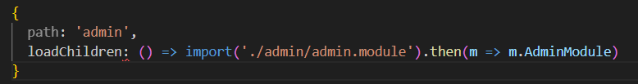
Lazy Loading (The Performance "Win")
Instead of loading everything at startup, Angular loads feature modules on demand.

Slide 13
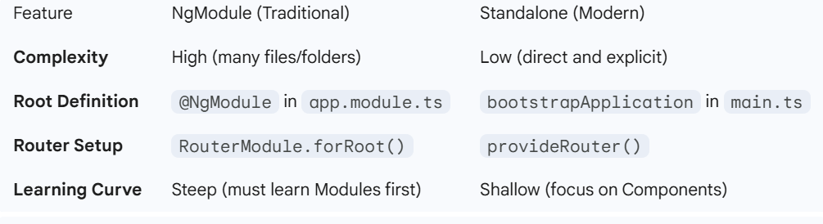
Module vs Standalone

Slide 14
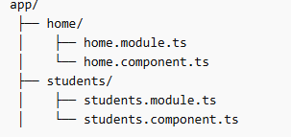


Task: Angular Modules & Routing
Create Angular project
Create two modules: HomeModule, StudentsModule. Each module must contain one component.
Create routes:
Routing must be configured in: app-routing.module.ts
4. Add Navigation Menu: In app.component.html add→

